Slide 1


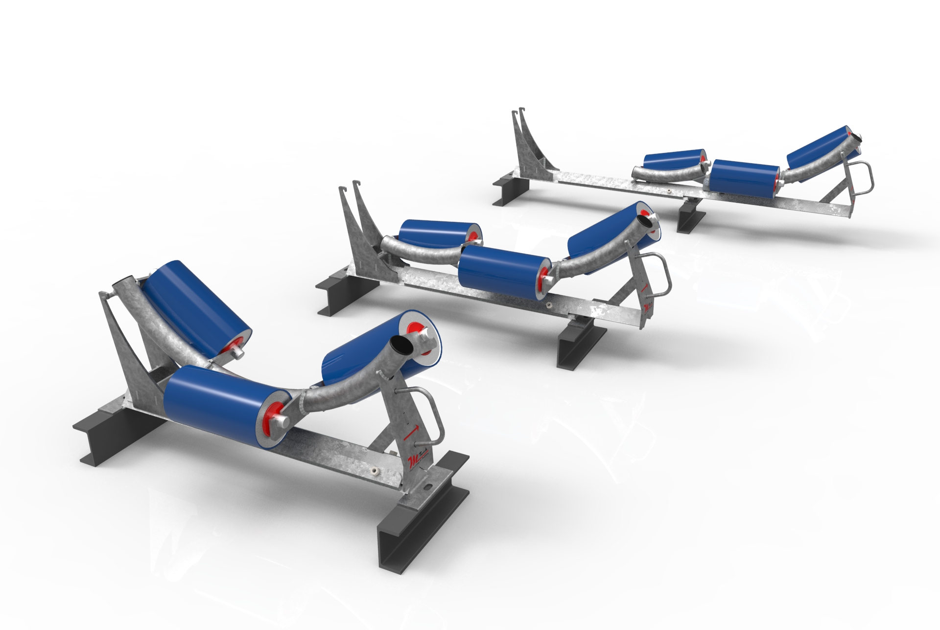
Collapsible Maintenance Idler Frame
(CMIF SYSTEM)

Slide 2
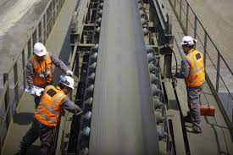
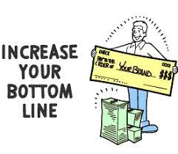
Questions:
Is safety important?
Do you want to decrease downtime and hence increase the bottom-line?

Slide 3
Solution
Increases safety around conveyors
Drastically reduce nip points
Eliminate working at heights
Increases conveyor maintenance efficiencies
Replace set of idler rollers within 3 min or less
Only one person required
Decrease plant downtime
Due to conveyor damage or Tearing of conveyor belting
Due to maintenance of idlers

Slide 4
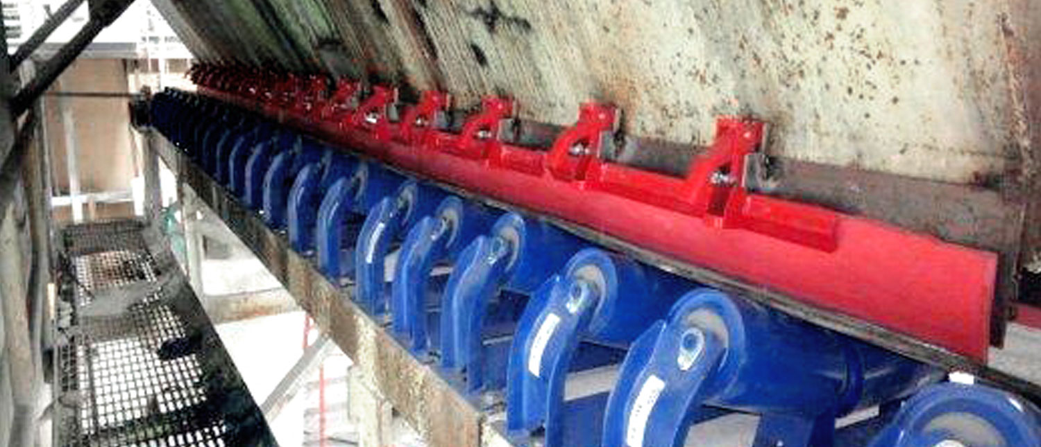
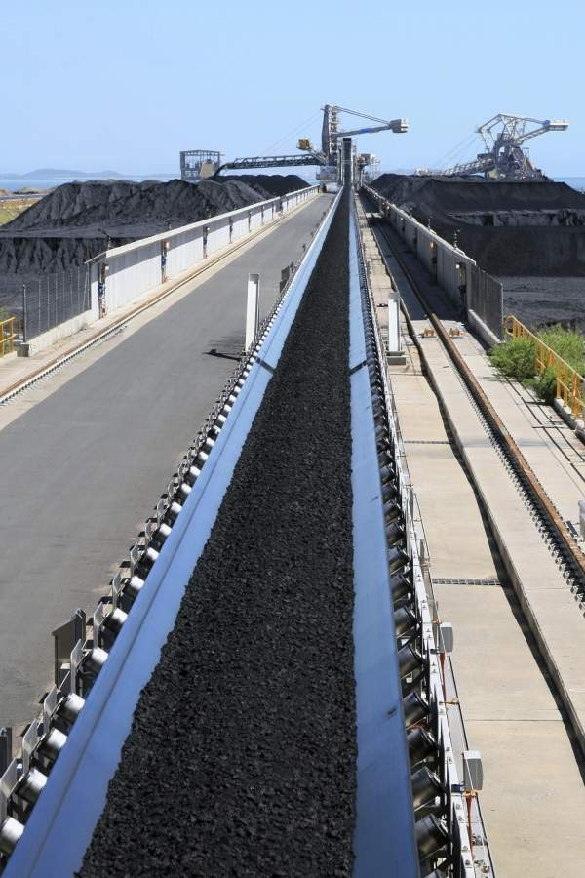
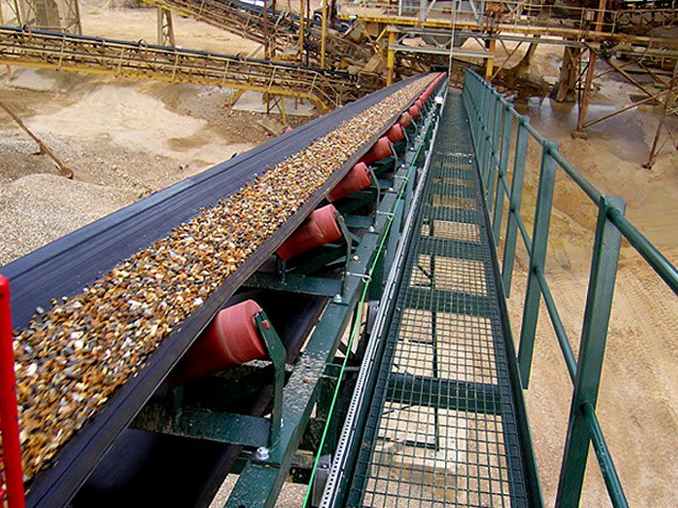
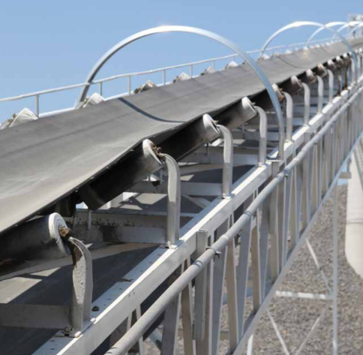
Current Practice
How are rollers replaced on;
Single walkway conveyors
Transfer points
Overland conveyors

Slide 5
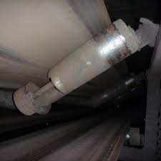
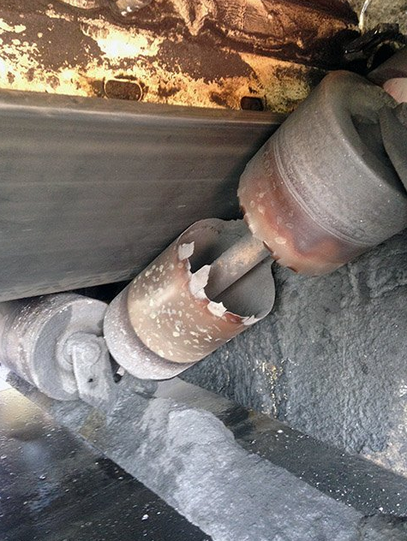

Human Factor
When maintenance is difficult, it’s not done
Lack of maintenance results in idlers to be worn through which causes
plant downtime due to belt damage.

Slide 6
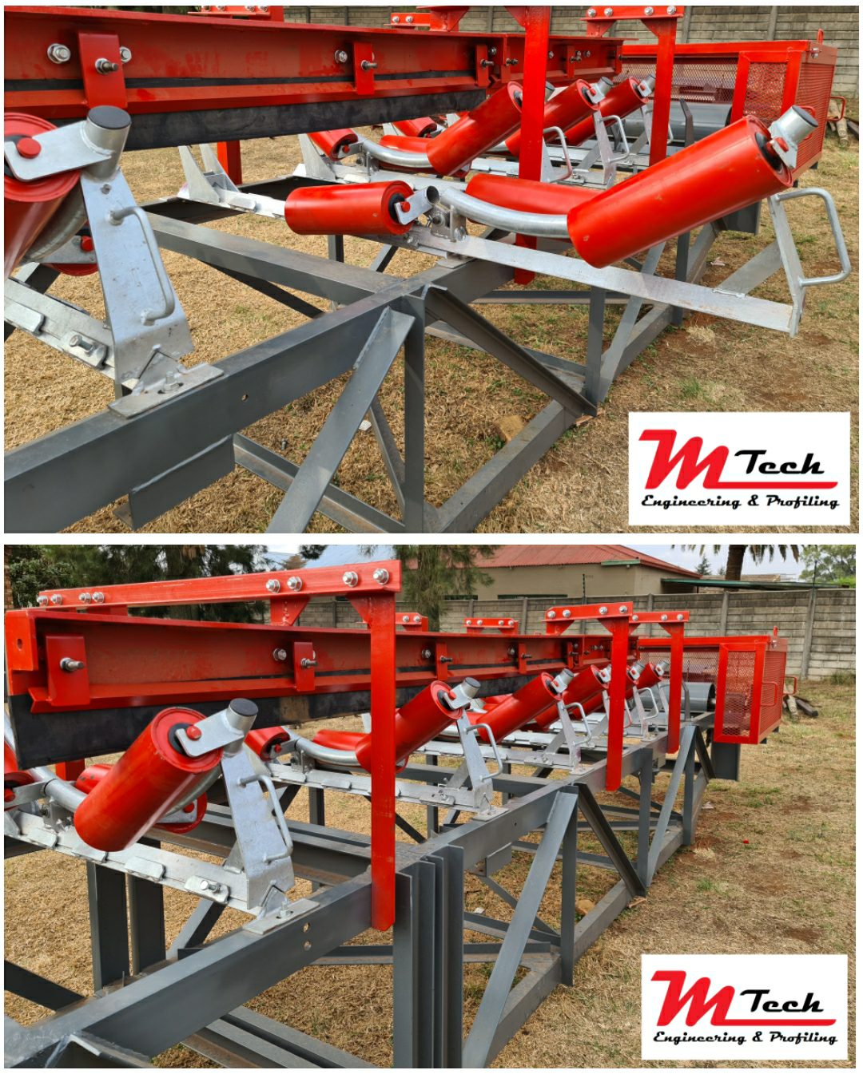
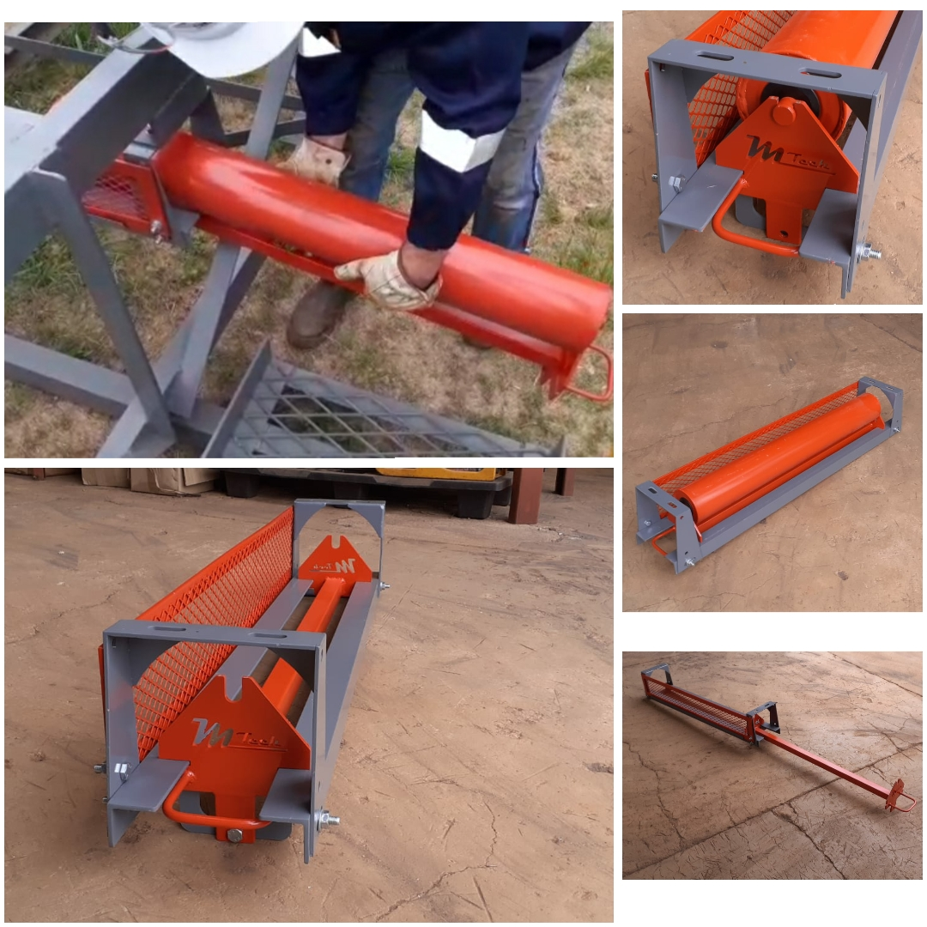
Documentation
CMIF - Std vs CMIF Comparison
CMIF – Installed Unit After 3 Months
RRIF
CMIF - Brochure

Slide 7
In Summary
You will:
Increase safety around conveyors
Increase conveyor maintenance efficiencies
Decrease plant downtime

